Slide 1
Product Information
®
GrindX
Better Safety Better Satisfy
주원 솔루션즈
경기도 안양시 동안구 시민대로 327번길 11-41,(관양동) 902호
www.GrindX.co.kr

Slide 2
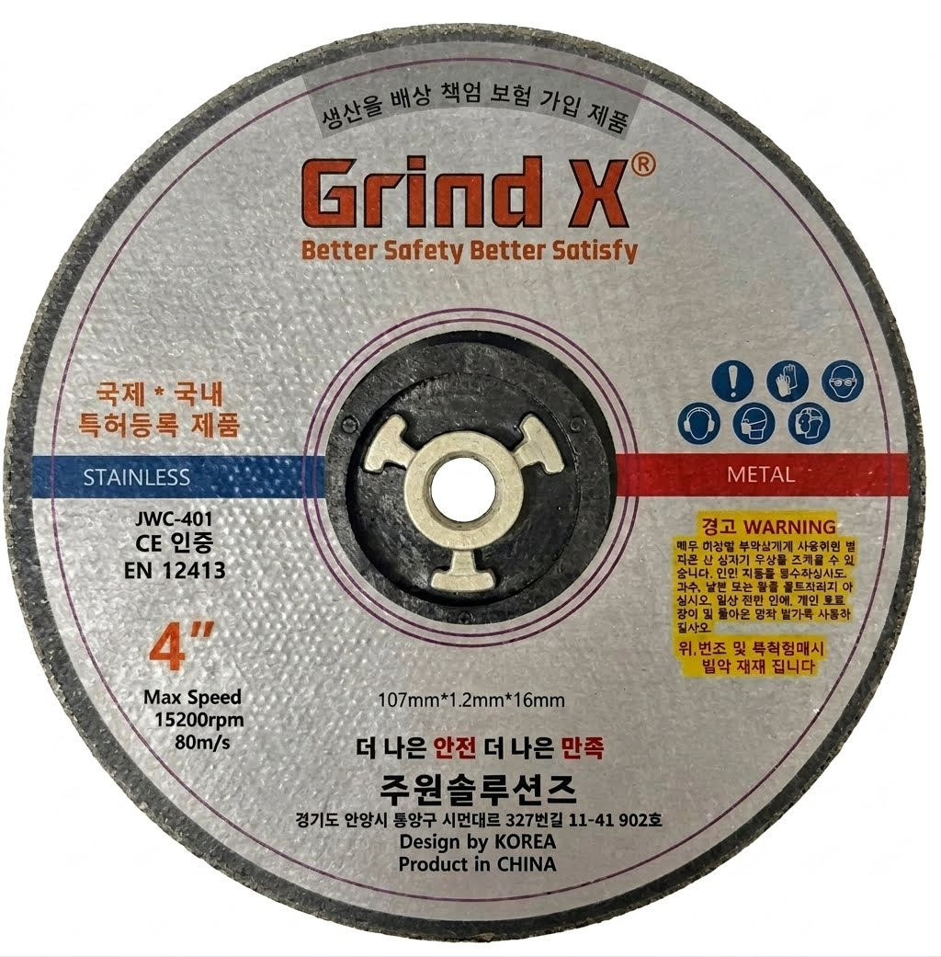






I N F O R M A T I O N
Product Name : Cutting Wheel
Model No : JWC : 401
Material : Ao, Ceramic…
Arbor Hole Material : NA0066G30
Target Material : Steel , Stainless
Package : 1pc/Polybag, 50pcs/Inner Box, 800pcs/Carton
Spec : 107mm*1.2T*16mm
Max Speed : 15,200 RPM/Min
Safety Notice
Safety Notice
To ensure safety, read safety regulations
And wear personal protective equipment (PPE).
안전한 작업을 위해 안전 규정을 숙지하고 보호용 장구를 착용하세요.

Slide 3
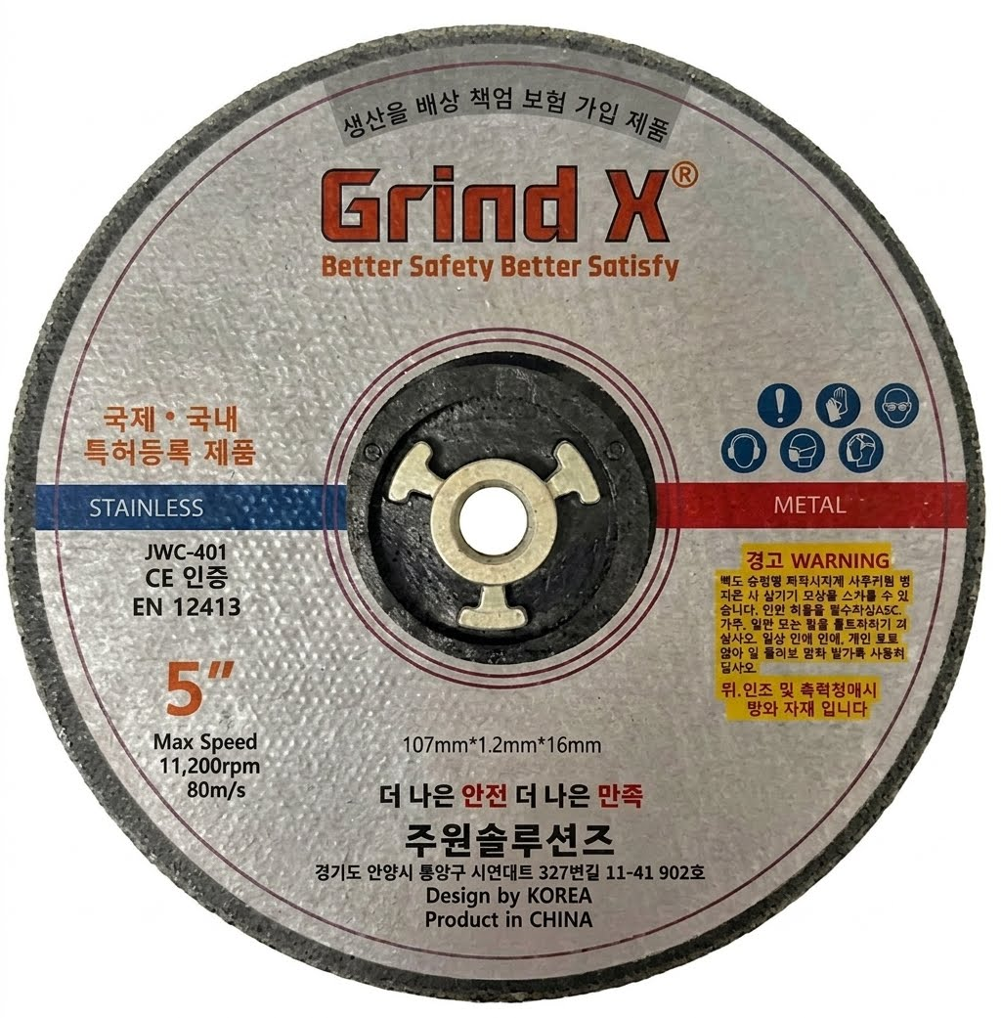
I N F O R M A T I O N
Product Name : Cutting Wheel
Model No : JWC : 501
Material : ZO,Ao,Ceramic…
Arbor Hole Material : NA0066G30
Target Material : Steel , Stainless
Package : 1pc/Polybag, 50pcs/Inner Box, 600pcs/Carton
Spec : 125mm*1.3T*16mm
Max Speed : 11,200 RPM/Min
Safety Notice
Safety Notice
To ensure safety, read safety regulations
And wear personal protective equipment (PPE).
안전한 작업을 위해 안전 규정을 숙지하고 보호용 장구를 착용하세요.

Slide 4
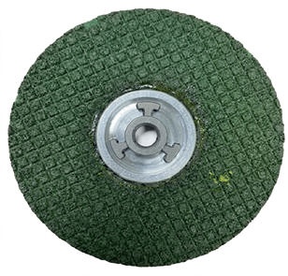
I N F O R M A T I O N
Product Name : Grinding Wheel
Model No : JWG : 401
Material : Ao
Arbor Hole Material : NA0066G30
Target Material : Steel , Stainless
Package : 1pc/Polybag, 50pcs/Inner Box, 400pcs/Carton
Spec : 107mm*3T*16mm
Max Speed : 15,200 RPM/Min
Safety Notice
Safety Notice
To ensure safety, read safety regulations
And wear personal protective equipment (PPE).
안전한 작업을 위해 안전 규정을 숙지하고 보호용 장구를 착용하세요.

Slide 5
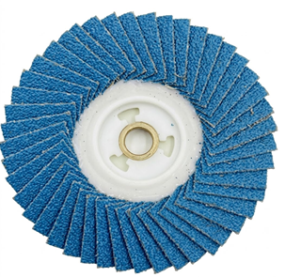
I N F O R M A T I O N
Product Name : Grinding Wheel
Model No : JWF : 401 #40
Material : Ao, Ceramic
Arbor Hole Material : NA0066G30
Target Material : Steel , Stainless
Package : 1pc/Polybag, 10pcs/Inner Box, 200pcs/Carton
Spec : 105mm*16mm
Max Speed : 15,300 RPM/Min
Safety Notice
Safety Notice
To ensure safety, read safety regulations
And wear personal protective equipment (PPE).
안전한 작업을 위해 안전 규정을 숙지하고 보호용 장구를 착용하세요.

Slide 6
I N F O R M A T I O N
Product Name : Grinding Wheel
Model No : JWF : 401 #80
Material : Ao, Ceramic
Arbor Hole Material : NA0066G30
Target Material : Steel , Stainless
Package : 1pc/Polybag, 10pcs/Inner Box, 200pcs/Carton
Spec : 105mm*16mm
Max Speed : 15,300 RPM/Min
Safety Notice
Safety Notice
To ensure safety, read safety regulations
And wear personal protective equipment (PPE).
안전한 작업을 위해 안전 규정을 숙지하고 보호용 장구를 착용하세요.

